Slide 1
Internet of Things: Protocols for IoT- Messaging and Transport
Lect # 13 - 15
Prof. Suchismita Chinara
Dept. of Computer Science Engg.
National Institute of Technology Rourkela-769008

Slide 2
Introduction
Messaging protocols act as the backbone of IoT.
They play a vital role to send and receive the data/message to /from the cloud for any IoT application.
Two major protocols in this regard are:
  MQTT (Message Queuing Telemetry Transport)
  CoAP (Constrained Application Protocol)

Slide 3
MQTT
MQTT is a light weight protocol, which makes it exceptionally useful.
Light weight means that it demands minimal resources for its functioning and does not require additional resources from its working environment.
IoT prefers this type of lightweight protocols due to resource constraint.

Slide 4
MQTT
MQTT follows the publish – subscribe pattern.
Thus, a central broker plays a key role in the entire system.
This message broker helps to dispatch messages to the nodes that have subscribed for the same.
The publisher node sends messages to the broker and the broker takes responsibility of dispatching the messages to the subscribed destinations.

Slide 5
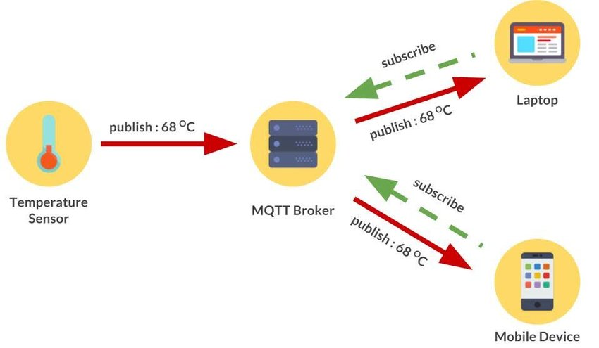
Example: MQTT broker

Slide 6
Characteristics of MQTT
It is a machine to machine protocol. (M2M)
It is a simple messaging protocol designed for the constrained devices and with low bandwidth
It provides faster data transmission. It's a real-time messaging protocol.
The latest version of MQTT (Ver 5.0) has the feature of enhancement in the scalability and the large-scale system in order to set up with the thousands or the millions of devices. (IoT)

Slide 7
MQTT Architecture
To understand the MQTT architecture, we first look at the components of the MQTT:
  Message
  Client
  Server or Broker
  TOPIC

Slide 8
Message
The message is the data that is carried out by the protocol across the network for the application.
When the message is transmitted over the network, it contains the following parameters:
  Payload data
  Quality of Service (QoS) (0 (unAcked)/1(Acked, retransmitted)/2 (RTS, CTS)
  Topic Name

Slide 9

MQTT Message Format
The MQTT uses the command and the command acknowledgment format.
This mechanism is similar to the handshaking mechanism as in TCP protocol.

Slide 10
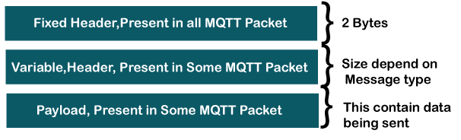
MQTT Packet Structure
The payload field basically contains the data which is being sent. Some commands do not use the payload field, for example, disconnect message.

Slide 11
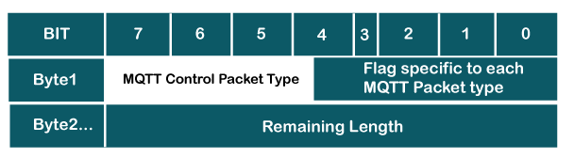
Fixed Header -2 bytes
MQTT Control Packet Type: It occupies 4 bits, i.e., 7 to 4-bit positions. This 4-bit is an assigned value, and each bit represents the MQTT control packet type.
Flag specific to each MQTT packet type: The remaining 4-bits represent flag specific to each MQTT packet type.

Slide 12
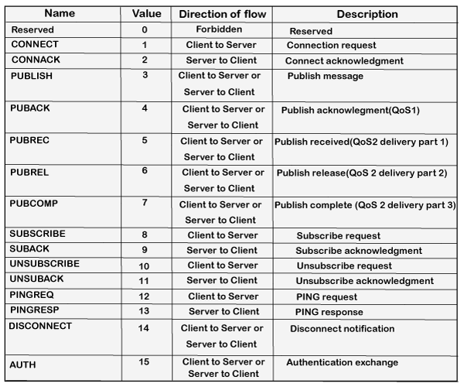
MQTT Control Packet Types (4 bits)

Slide 13
Fixed Header: Remaining Length
The byte 2 contains the remaining length, which is a variable-length byte integer.
It represents the number of bytes remaining in a current packet, including data in the variable header and payload.
Remaining length = length of variable header + length of payload
For example, if the length of the variable header is 20 and the length of the payload is 30, then the remaining length is 50.
This field uses 7-bit for the lengths, and MSB bit can be used as a continue flag. If the continuation flag is 1, the next byte is also a part of the remaining length.
If the continuation flag is 0, the byte is the last one of the remaining length.

Slide 14
Variable Header
Some types of MQTT control packet types contain an optional variable header component.
The content of the variable header depends upon the packet type.
The variable header contains the packet identifier field, which is common in several packet types.
The variable header component of many MQTT control packet types includes 2-byte integer, i.e., the packet identifier field.

Slide 15
Example: Packet identifier field
PUBLISH
PUBACK
PUBREC
PUBREL
PUBCOMP
SUBSCRIBE
SUBACK
UNSUBSCRIBE
UNSUBACK

Slide 16
Key points related to the packet identifier field:
A PUBLISH packet should not contain the packet identifier field if the value of QoS is set to zero. It implies that if the value of QoS is greater than zero, only the PUBLISH packet will contain the packet identifier field.
When a client sends a new SUBSCRIBE, UNSUBSCRIBE, or PUBLISH MQTT control packet, it should assign a non-zero packet identifier that is currently unused.
A PUBACK, PUBREC, PUBUREL, are the acknowledgment packets of PUBLISH command that contain the same packet identifier as the PUBLISH packet.
A SUBACK and UNSUBACK are the acknowledgment packets of SUBSCRIBE and UNSUBSCRIBE, respectively. Both the packets, i.e., SUBACK and UNSUBACK, use the same packet identifier as the SUBSCRIBE and UNSUBSCRIBE packets.

Slide 17
Payload
The last MQTT control packet is the payload. This field contains the data which is to be sent. For example, in the case of the CONNECT packet, the payload is a client ID, the username and password, and for the PUBLISH packet, the payload is just an application message.

Slide 18
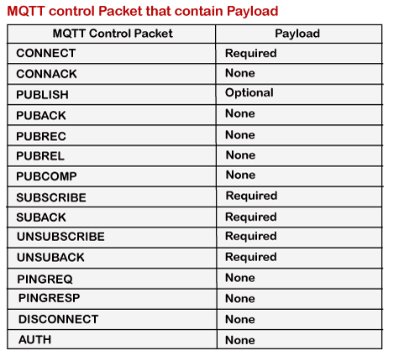

Slide 19
Client
In MQTT, the subscriber and publisher are the two roles of a client.
The clients subscribe to the topics to publish and receive messages.
A device is a client if it opens the network connection to the server/ publishes messages that other clients want to see/ subscribes to the messages that it is interested in receiving/ unsubscribes to the messages that it is not interested in receiving/ and closes the network connection to the server. (If any program or device uses an MQTT, then that device is referred to as a client. )

Slide 20
Example: Client & Broker Architecture

Slide 21
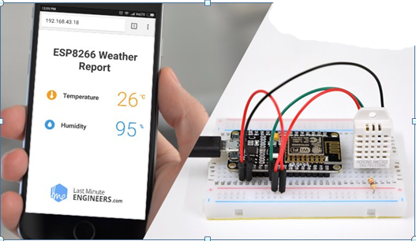
Example: MQTT implementation

Slide 22
MQTT Public / Subscribe Pattern
The publish/subscribe pattern provides an alternative to traditional client-server architecture.
In the client-sever model, a client communicates directly with an end point.
The pub/sub model decouples the client that sends a message (the publisher) from the client that receives the messages (the subscribers).
The publishers and subscribers never contact each other directly.
In fact, they are not even aware that the other exists. The connection between them is handled by a third component (the broker).
The job of the broker is to filter all incoming messages and distribute them correctly to subscribers.

Slide 23
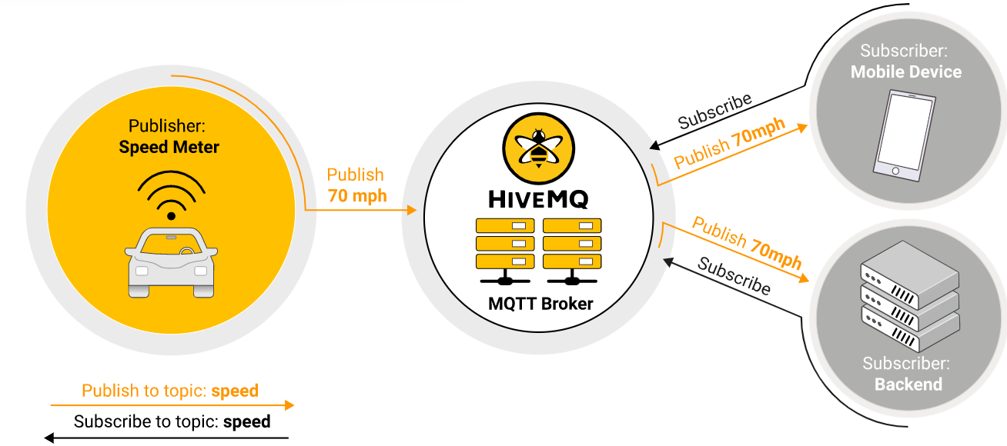
Ex: MQTT Pub/Sub Architecture

Slide 24
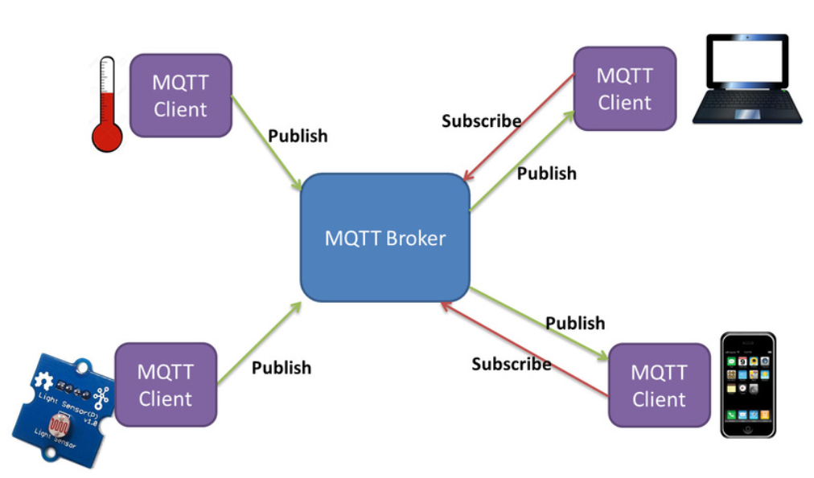
Ex: MQTT Pub/Sub Architecture

Slide 25
Public / Subscribe Pattern
The decoupling of the publisher of the message from the subscriber has several dimensions:
  Space decoupling: Publisher and subscriber do not need to know each other (for example, no exchange of IP address and port).
  Time decoupling: Publisher and subscriber do not need to run at the same time.
  Synchronization decoupling: Operations on both components do not need to be interrupted during publishing or receiving.
In summary, the pub/sub model removes direct communication between the publisher and the subscriber.
The filtering activity of the broker makes it possible to control which client/subscriber receives which message.

Slide 26
Message Filtering
But how does the broker manage to filter all the messages so that each subscriber receives only messages of interest? The broker has several filtering options:
SUBJECT-BASED FILTERING:
  This filtering is based on the subject or topic that is part of each message.
  The receiving client subscribes to the broker for topics of interest.
  The broker ensures that the receiving client gets all message published to the subscribed topics.
  In general, topics are strings with a hierarchical structure that allow filtering based on a limited number of expressions.
CONTENT-BASED FILTERING:
  In content-based filtering, the broker filters the message based on a specific content filter-language.
  The receiving clients subscribe to filter queries of messages for which they are interested.

Slide 27

TOPIC
The label provided to the message is checked against the subscription known by the server is known as TOPIC.

Slide 28
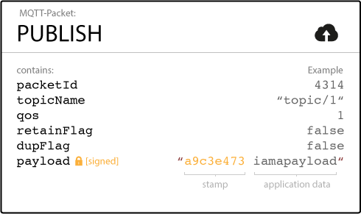
Operations of MQTT Client
In MQTT, the client performs two operations:
  Publish: When the client sends the data to the server, then we call this operation as a publish.

Slide 29
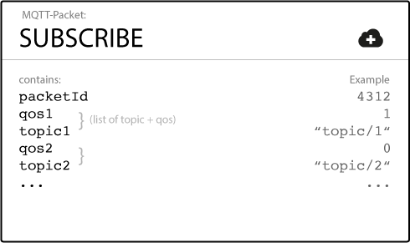
Operations of MQTT Client
  Subscribe: When the client receives the data from the server, then we call this operation a subscription.

Slide 30
Operations of MQTT Client
In MQTT, the client performs two operations:
  Publish: When the client sends the data to the server, then we call this operation as a publish.

Slide 31
Operations of MQTT Client
  Subscribe: When the client receives the data from the server, then we call this operation a subscription.

Slide 32
MQTT Broker:
The counterpart of the MQTT client is the MQTT broker. Depending on the implementation, a broker can handle up to millions of concurrently connected MQTT clients.
The broker is responsible for receiving all messages, filtering the messages, determining who is subscribed to each message, and sending the message to these subscribed clients.
Another responsibility of the broker is the authentication and authorization of client.

Slide 33
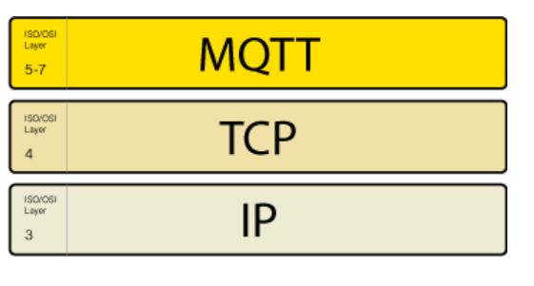

MQTT Connection
The MQTT protocol is based on TCP/IP. Both the client and the broker need to have a TCP/IP stack.
The MQTT connection is always between one client and the broker.
Clients never connect to each other directly.
To initiate a connection, the client sends a CONNECT message to the broker. The broker responds with a CONNACK message and a status code.

Slide 34
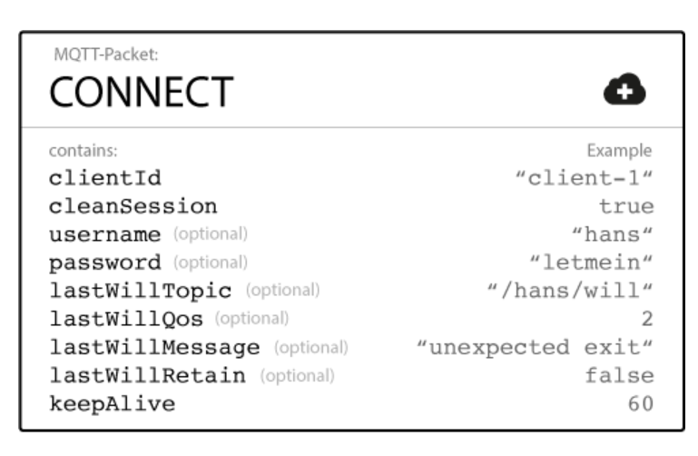
MQTT CONNECT
To initiate a connection, the client sends a command message to the broker. If this CONNECT message is malformed (according to the MQTT specification) or too much time passes between opening a network socket and sending the connect message, the broker closes the connection.

Slide 35
MQTT CONNECT
Client Id:
  The client identifier (Client Id) identifies each MQTT client that connects to an MQTT broker. The broker uses the Client Id to identify the client and the current state of the client. Therefore, this Id should be unique per client and broker.
Clean Session
  The clean session flag tells the broker whether the client wants to establish a persistent session or not. In a persistent session (Clean Session = false), the broker stores all subscriptions for the client. If the session is not persistent (Clean Session = true), the broker does not store anything for the client and purges all information from any previous persistent session.

Slide 36
MQTT CONNECT
Username/Password
  MQTT can send a user name and password for client authentication and authorization. Brokers like Hive MQ can authenticate clients with an SSL certificate.
Keep Alive
  The keep alive is a time interval in seconds that the client specifies and communicates to the broker when the connection established. This interval defines the longest period of time that the broker and client can endure without sending a message. The client commits to sending regular PING Request messages to the broker. The broker responds with a PING response. This method allows both sides to determine if the other one is still available.

Slide 37
MQTT Broker
Broker responses with a CONNACK message
When a broker receives a CONNECT message, it is obligated to respond with a CONNACK message.
The CONNACK message contains two data entries:
  The session present flag
  A connect return code

Slide 38
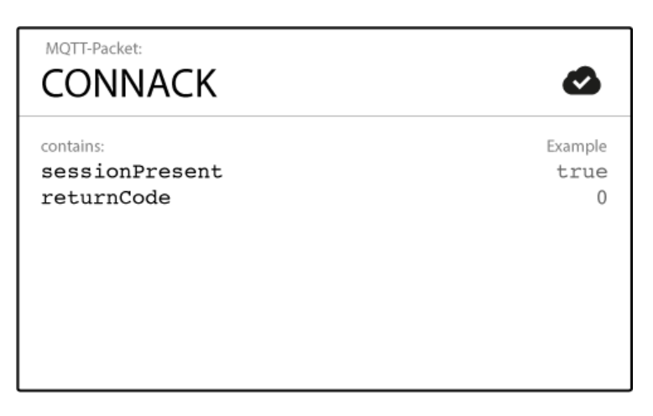
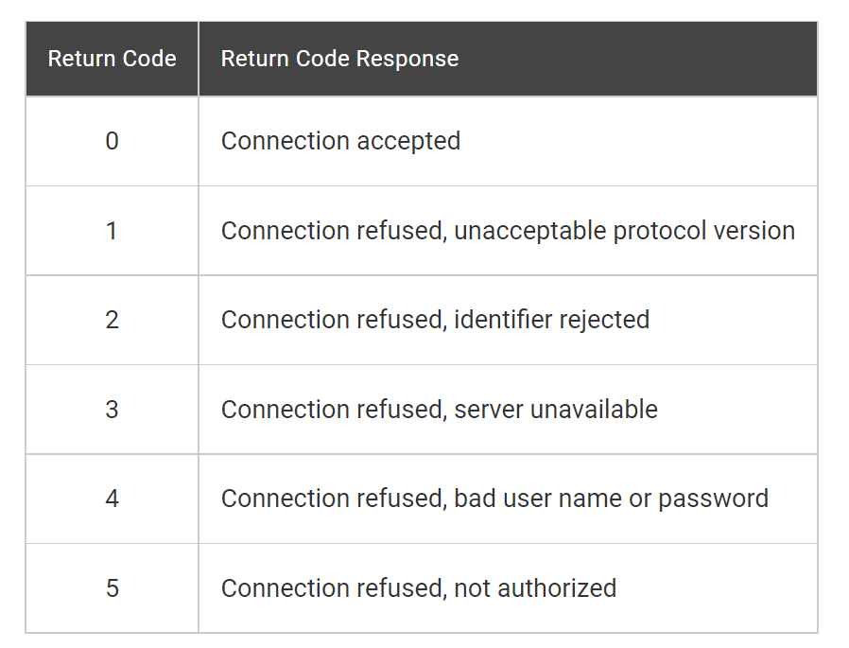
Ex: CONNACK MSG

Slide 39
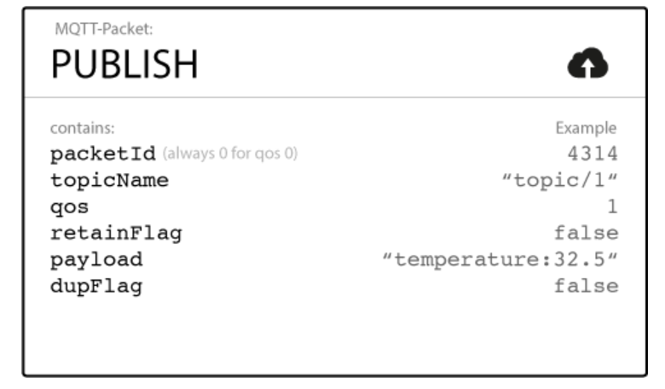
MQTT Messages
Publish:
An MQTT client can publish messages as soon as it connects to a broker.
MQTT utilizes topic-based filtering of the messages on the broker.
Each message must contain a topic that the broker can use to forward the message to interested clients.

Slide 40
MQTT Publish
Packet Identifier: This uniquely identifies a message as it flows between the client and broker. The packet identifier is only relevant for QoS levels greater than zero.
Topic Name The topic name is a simple string that is hierarchically structured with forward slashes as delimiters. For example, “myhome/ livingroom/ temperature”.
QoS This number indicates the Quality of Service Level (QoS) of the message. There are three levels: 0, 1, and 2. The service level determines what kind of guarantee a message has for reaching the intended recipient (client or broker).
Retain Flag This flag defines whether the message is saved by the broker for a specified topic. When a new client subscribes to a topic, they receive the last message that is retained on that topic.

Slide 41
MQTT Publish
Payload This is the actual content of the message. It is possible to send images, text in any encoding, encrypted data, and virtually every data in binary.
DUP flag The flag indicates that the message is a duplicate and was resent because the intended recipient (client or broker) did not acknowledge the original message. This is only relevant for QoS greater than 0.

Slide 42
MQTT Publish
The client that initially publishes the message is only concerned about delivering the PUBLISH message to the broker.
Once the broker receives the PUBLISH message, it is the responsibility of the broker to deliver the message to all subscribers.
The publishing client does not get any feedback about whether anyone is interested in the published message or how many clients received the message from the broker.

Slide 43
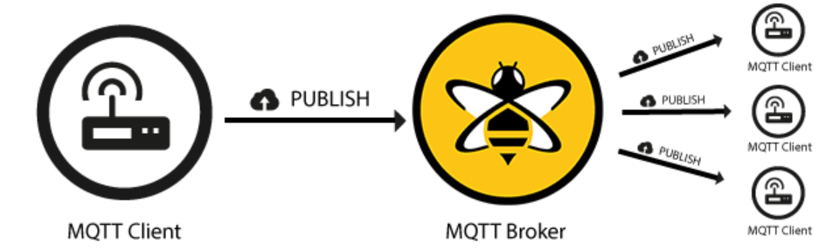
Ex: PUBLISH

Slide 44
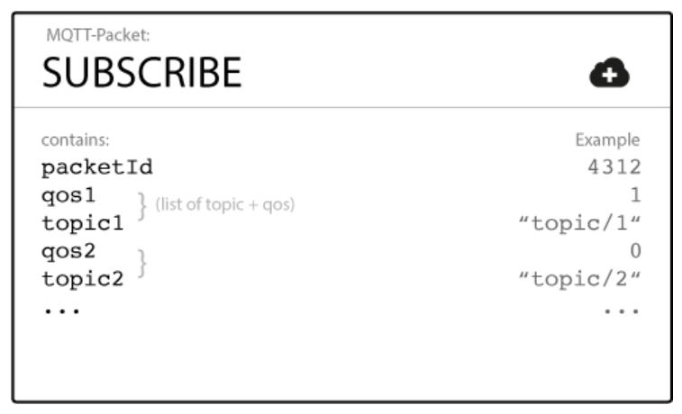
MQTT Subscribe
Publishing a message doesn’t make sense if no one ever receives it. In other words, if there are no clients to subscribe to the topics of the messages.
To receive messages on topics of interest, the client sends a SUBSCRIBE message to the MQTT broker.

Slide 45
MQTT Subscribe
Packet Identifier The packet identifier uniquely identifies a message as it flows between the client and broker. The client library and/or the broker is responsible for setting this internal MQTT identifier.
List of Subscriptions A SUBSCRIBE message can contain multiple subscriptions for a client. Each subscription is made up of a topic and a QoS level.

Slide 46
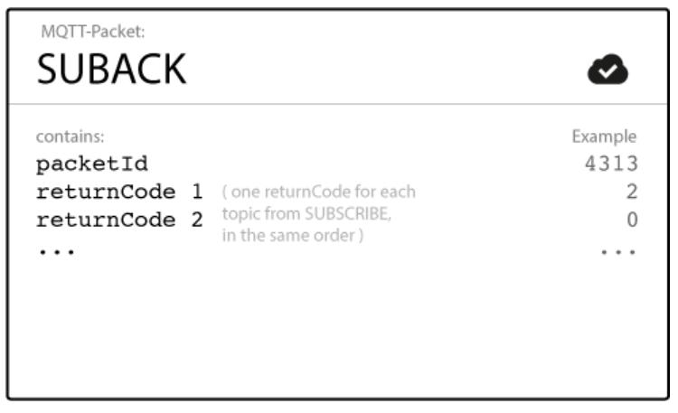
MQTT SUBACK
To confirm each subscription, the broker sends a SUBACK acknowledgement message to the client. This message contains the packet identifier of the original Subscribe message (to clearly identify the message) and a list of return codes.

Slide 47
MQTT SUBACK
Packet Identifier The packet identifier is a unique identifier used to identify a message. It is the same as in the SUBSCRIBE message.
Return Code The broker sends one return code for each topic/QoS-pair that it receives in the SUBSCRIBE message. For example, if the SUBSCRIBE message has five subscriptions, the SUBACK message contains five return codes. The return code acknowledges each topic and shows the QoS level that is granted by the broker. If the broker refuses a subscription, the SUBACK message contains a failure return code for that specific topic. For example, if the client has insufficient permission to subscribe to the topic or the topic is malformed.

Slide 48
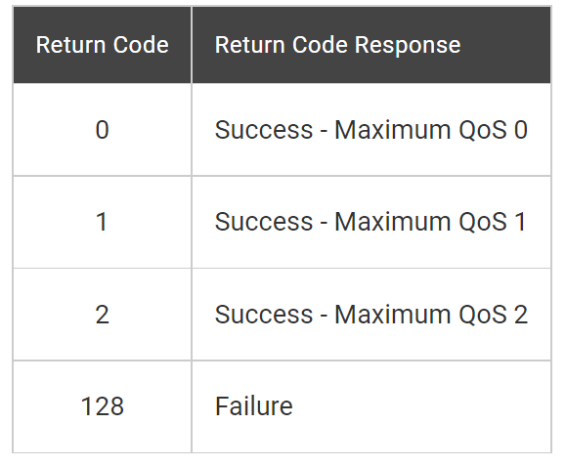
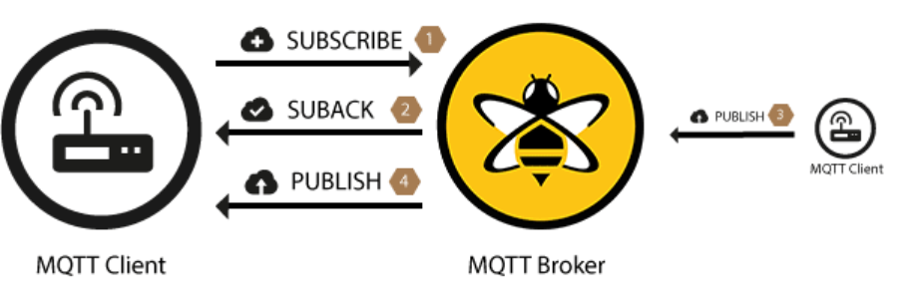
MQTT SUBACK
After a client successfully sends the SUBSCRIBE message and receives the SUBACK message, it gets every published message that matches a topic in the subscriptions that the SUBSCRIBE message contained.

Slide 49
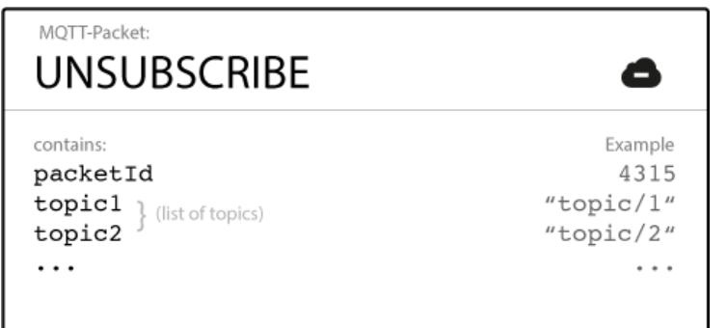
MQTT UNSUBSCRIBE
The counterpart of the SUBSCRIBE message is the UNSUBSCRIBE message.
This message deletes existing subscriptions of a client on the broker. The UNSUBSCRIBE message is similar to the SUBSCRIBE message and has a packet identifier and a list of topics.

Slide 50
MQTT UNSUBSCRIBE
Packet Identifier The packet identifier uniquely identifies a message as it flows between the client and broker. The client library and/or the broker is responsible for setting this internal MQTT identifier.
List of Topic The list of topics can contain multiple topics from which the client wants to unsubscribe. It is only necessary to send the topic (without QoS).

Slide 51
MQTT UNSUBACK
To confirm the unsubscribe, the broker sends an UNSUBACK acknowledgement message to the client. This message contains only the packet identifier of the original UNSUBSCRIBE message (to clearly identify the message).
Packet Identifier The packet identifier uniquely identifies the message. As already mentioned, this is the same packet identifier that is in the UNSUBSCRIBE message.

Slide 52

Ex: UNSUBSCRIBE

